Slide 1
Project Presentation of Co-Op2 Project at Industry
On
Adidas Sales Analysis
Submitted By:
Name: Anika Kaushish
Roll No.: 2210990113
Supervised By:
Name: Jatin Mehta
Designation: Director
Organization: Logic Zephyr Pvt. Ltd.
Department of Computer Science and Engineering,
Chitkara University, Punjab

Slide 2
Introduction
In today’s data-driven world, organizations generate large amounts of sales data, but raw data alone is not useful for decision-making. Data analysis and visualization tools such as Power BI help transform raw data into meaningful insights through dashboards and reports. This project focuses on analyzing Adidas sales data to understand sales trends, regional performance, product performance, and retailer contributions. The dashboard provides a visual representation of key business metrics which helps management make strategic decisions.

Slide 3
Problem Statement
Companies like Adidas generate huge volumes of sales data across different regions, products, and retailers. However, analyzing this data manually is difficult and time-consuming. Without proper visualization, it is challenging to identify sales trends, top-performing products, profitable regions, and retailer performance. Therefore, there is a need to develop an interactive dashboard that can analyze sales data efficiently and provide insights for better business decision-making.

Slide 4
Objectives of the Project
To analyze Adidas sales data
To create an interactive Power BI dashboard
To analyze monthly sales trends
To identify top-performing regions and products
To analyze retailer performance
To visualize key performance indicators

Slide 5
Key Features of Dashboard
The Adidas Sales Dashboard includes several important features:
KPI Cards showing Total Sales, Units Sold, Profit, and Price per Unit
Monthly Sales Trend Line Chart
Sales by State Map Visualization
Sales by Region Pie Chart
Sales by Product Bar Chart
Sales by Retailer Bar Chart
Filters for Region and Date

Slide 6
Key Performance Indicators (KPIs)
Total Sales : $900M
Units Sold : 2M
Operating Margin : 42%
Price per Unit : $45
Operating Profit : $332M
Methodology
Step 1: Data Collection
Step 2 : Data Cleaning
Step 3 : Data Loading in Power BI
Step 4 : Data Modelling
Step 5 : Creating Visualizations
Step 6 : Dashboard Creation
Step 7 : Insight Generation

Slide 7
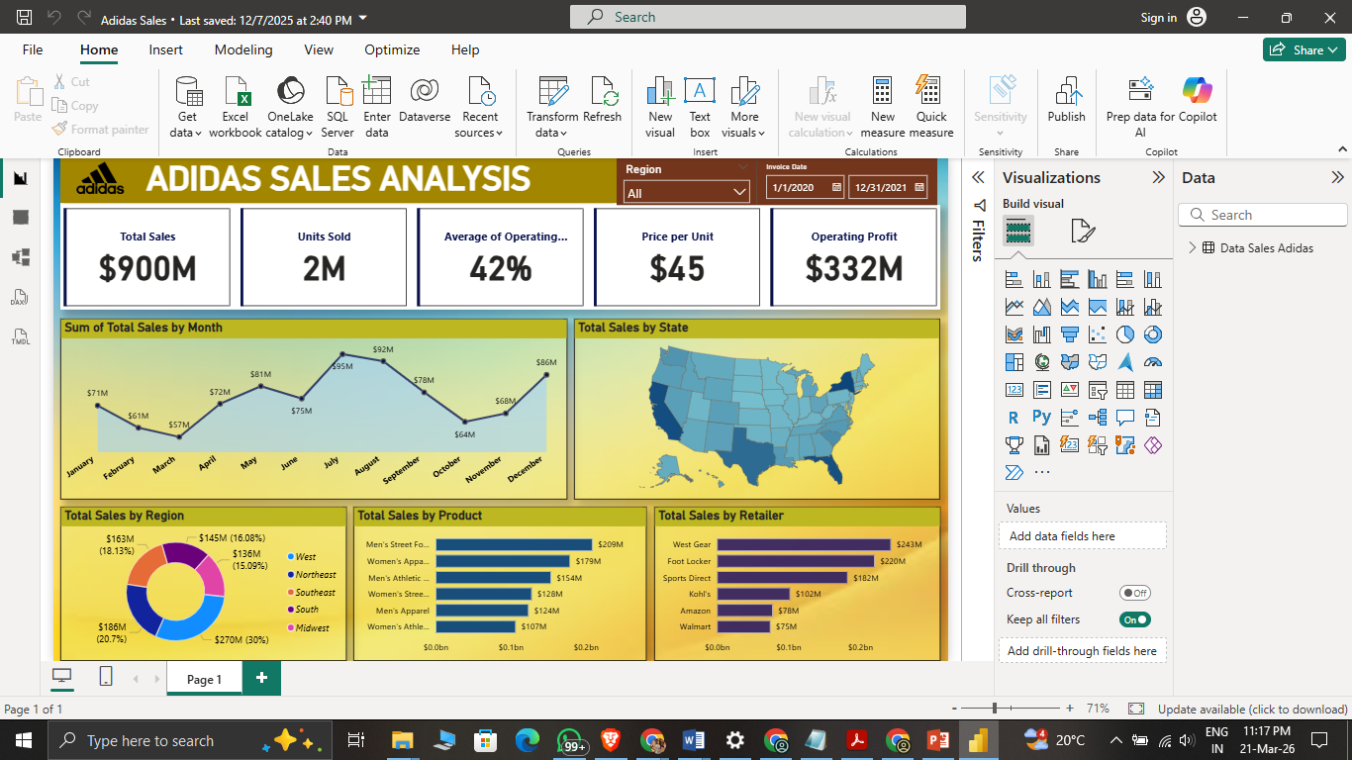

Slide 8
Monthly Sales Analysis
The monthly sales line chart shows the trend of sales throughout the year. From the dashboard, it can be observed that sales are higher in mid-year months such as July and August, while sales are lower at the beginning of the year. This indicates seasonal demand patterns which can help the company in inventory planning and marketing strategies.
Sales by Region Analysis
The sales by region chart shows that the West region contributes the highest sales compared to other regions such as Northeast, Southeast, South, and Midwest. This helps the company understand which regions are performing well and where improvement is required.

Slide 9
Sales by Product Analysis
The product sales chart shows that Men’s Street Footwear generates the highest sales among all products, followed by Women’s Apparel and Men’s Athletic Footwear. This helps the company focus more on high-performing products and improve low-performing products.
Sales by Region Analysis
The retailer sales chart shows that West Gear and Foot Locker are the top retailers contributing the highest sales. Retailer analysis helps the company maintain strong relationships with high-performing retailers and improve performance with low-performing retailers.

Slide 10
Insights from Dashboard
West region has highest sales
Men’s Street Footwear is top product
West Gear is top retailer
July & August are highest sales months
Overall profit is high

Slide 11
Conclusion
This project demonstrates how Power BI can be used to analyze sales data and create interactive dashboards. The Adidas Sales Dashboard helps in understanding sales trends, regional performance, product performance, and retailer performance. The dashboard provides useful insights that can help management in strategic decision-making and business growth.
Future Scope
Add customer segmentation
Add profit forecasting
Add yearly growth analysis
Add inventory analysis

Slide 12
Thank You

